Slide 1
“Company” Data Analysis Report
“jan - feb – Mar”

Slide 2
Method Approach
Data Manipulation and Cleaning
Analysis & Visualization
Dashboard
Automation
Rate Simulation
Answering Business Questions
Insights & Recommendation

Slide 3

Data Manipulation & Cleaning

Slide 4
Data Manipulation & Cleaning
Cleaning raw data Column renaming
Integrity Checks
Remove Null
Data Inspection
Understanding the data
Removing null values
Analysis Preparation
Pulling data from multiple sheets and merge into one master sheet
Update new column follow specified rule

Slide 5

Analysis & Visualization

Slide 6
Analysis and Visualization
Answering and Visualizations from the data:
Total Billing per Client
Gross Margins by Client %
Gross Margins by Country %
Gross Margins by Carrier %
Gross Margins by Number %
Total Cost per Vendor
Gross Margin by Country/Carrier/Client

Slide 7
Total Billing per Client
Customer | Total Billing per Client
Client 22 | 1459.01
Client 2 | 1650.35
Client 15 | 2497.68
Client 1 | 2584.75
Client 3 | 4219.41
Client 10 | 10418.98
Client 26 | 11504.19
Client 8 | 17142.29
Client 37 | 20384.75
Client 4 | 20431.43
Grand Total | 92292.84

Slide 8
Gross Margin by Client %
Customer | Gross Margin Percentage
Client 39 | 98.23%
Client 45 | 90.59%
Client 18 | 86.93%
Client 32 | 85.62%
Client 9 | 84.20%
Client 7 | 73.70%
Client 24 | 70.00%
Client 14 | 70.00%
Client 42 | 64.89%
Client 6 | 63.92%
Client 33 | 62.52%
Client 43 | 62.49%
Client 35 | 57.38%
Client 19 | 56.07%
Client 40 | 55.55%
Client 16 | 55.06%
Client 8 | 54.61%
Client 44 | 54.36%
Client 13 | 53.01%
Client 11 | 51.20%
Client 41 | 47.57%
Client 10 | 47.48%
Client 28 | 46.66%
Client 30 | 45.87%
Client 46 | 45.00%
Client 1 | 44.74%
Client 17 | 43.02%
Client 52 | 43.01%
Client 34 | 40.68%
Client 47 | 40.28%
Client 38 | 39.84%
Client 12 | 39.38%
Client 20 | 38.86%
Client 53 | 38.81%
Client 36 | 38.00%
Client 5 | 37.03%
Client 51 | 36.99%
Client 31 | 36.92%
Client 49 | 36.56%
Client 37 | 36.31%
Client 4 | 36.24%
Client 25 | 35.54%
Client 3 | 33.01%
Client 2 | 32.93%
Client 29 | 32.67%
Client 50 | 32.24%
Client 48 | 31.10%
Client 15 | 30.83%
Client 21 | 30.77%
Client 22 | 30.16%
Client 26 | 25.69%
Client 27 | 24.94%
Client 23 | 20.00%

Slide 9
Gross Margin by Country %
Country | Gross Margin Percentage
United Kingdom | 53.53%
France | 44.69%
South Africa | 42.80%
China | 37.88%
Greece | 36.16%
Australia | 32.96%
Chile | 32.07%
United States | 28.95%

Slide 10
Gross Margin by vendor type %
Vendor Type | Gross Margin Percentage
Vendor 1 | 35.18%
Vendor 2 | 40.82%
Vendor 3 | 42.49%
Vendor 4 | 35.23%
Vendor 5 | 73.61%

Slide 11
Gross Margin by number type %
Number Type | Gross Margin Percentage
ITFS | 40.63%
DID | 38.95%
TrueLocal | 33.83%

Slide 12
Gross margin country | vendor | client
Row Labels | Gross Margin Percentage
Australia | 77.12%
Vendor 1 | 53.69%
Vendor 2 | 91.47%
Vendor 3 | 70.00%
Vendor 4 | 85.00%
Vendor 5 | 89.95%
Chile | 90.97%
Vendor 2 | 90.97%
China | 43.82%
Vendor 1 | 55.75%
Vendor 2 | 98.08%
Vendor 3 | 40.00%
Vendor 4 | 49.75%
Vendor 5 | 47.50%
France | 59.74%
Vendor 1 | 47.48%
Vendor 2 | 98.23%
Vendor 3 | 70.00%
Vendor 4 | 75.00%
Vendor 5 | 88.98%
Greece | 51.39%
Vendor 1 | 42.79%
Vendor 2 | 86.65%
Vendor 5 | 44.58%
South Africa | 38.77%
Vendor 2 | 90.60%
Vendor 3 | 30.26%
United Kingdom | 73.70%
Vendor 1 | 84.09%
Vendor 2 | 93.67%
Vendor 3 | 87.27%
Vendor 4 | 68.89%
Vendor 5 | 95.00%
United States | 38.28%
Vendor 2 | 38.97%
Vendor 3 | 34.33%
Vendor 4 | 54.87%
Vendor 5 | 35.87%

Slide 13
dashboard

Slide 14
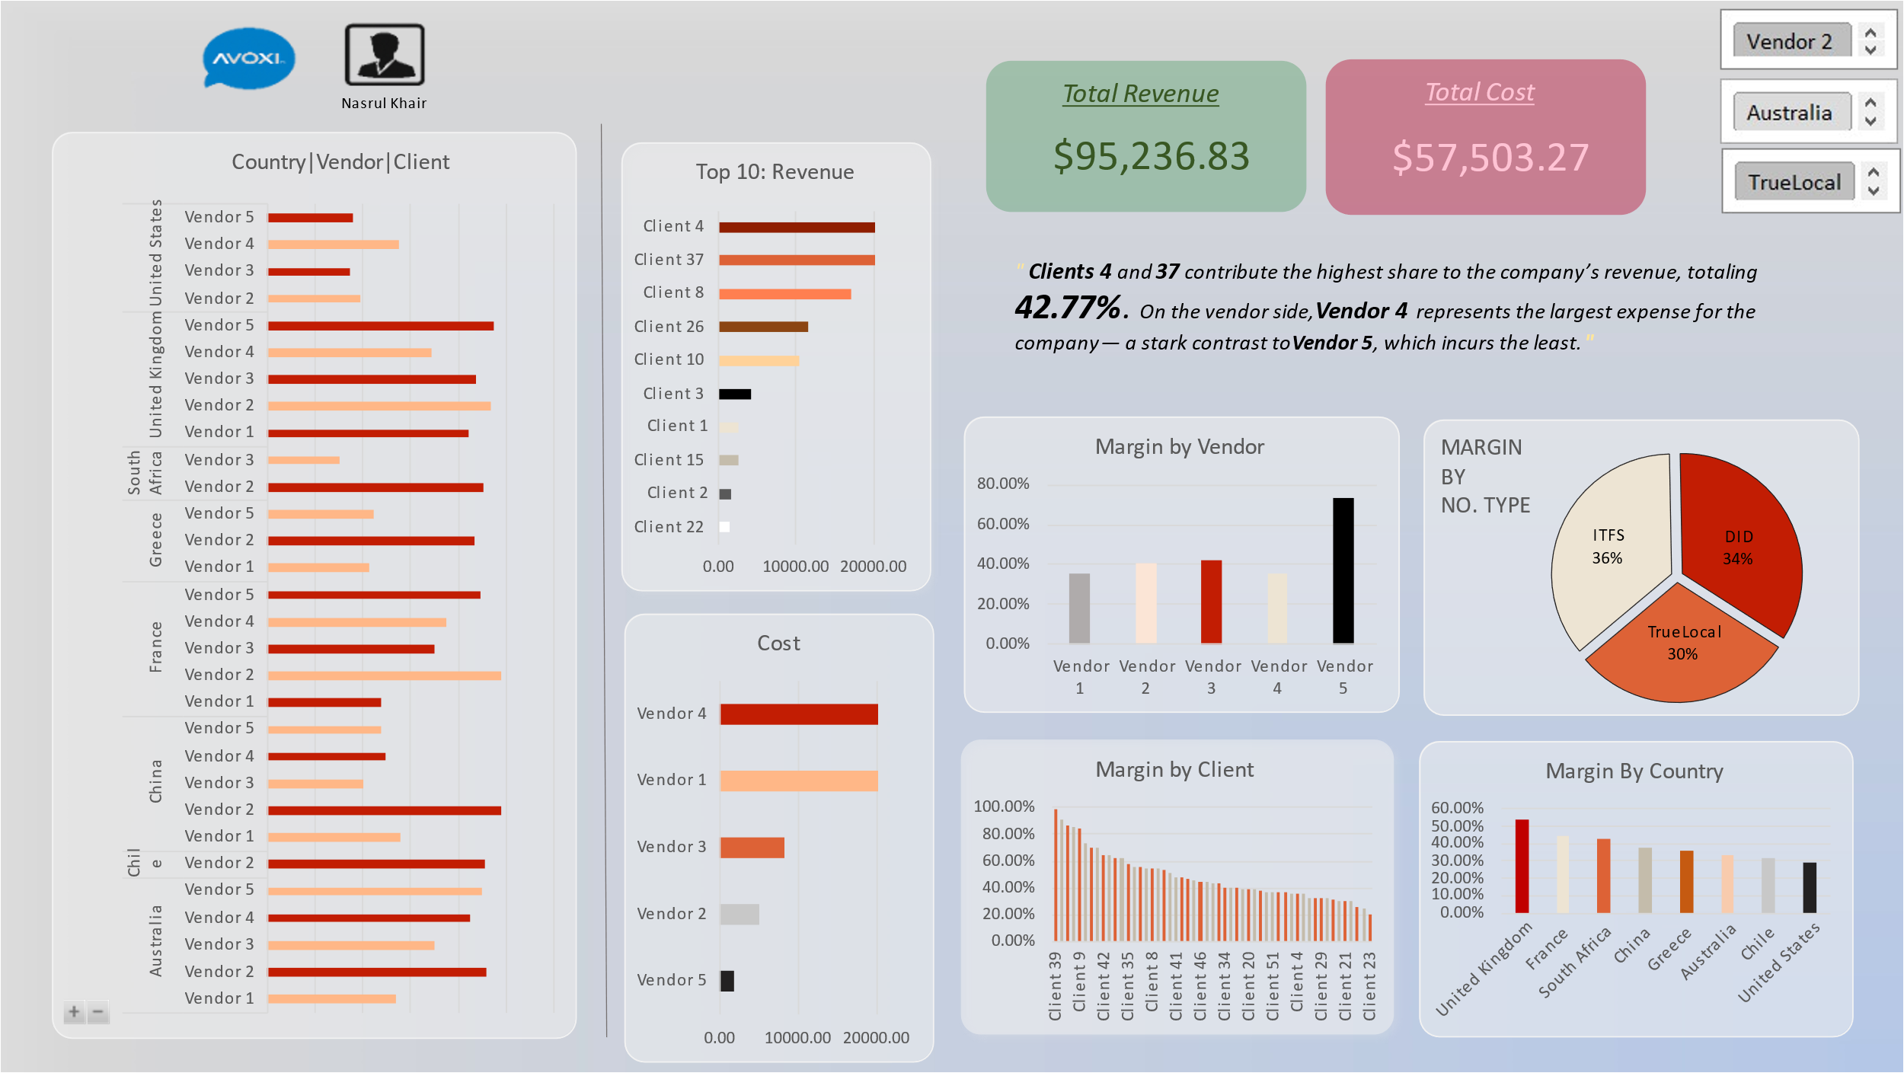
Total Billing per Client

Slide 15
Automation

Slide 16
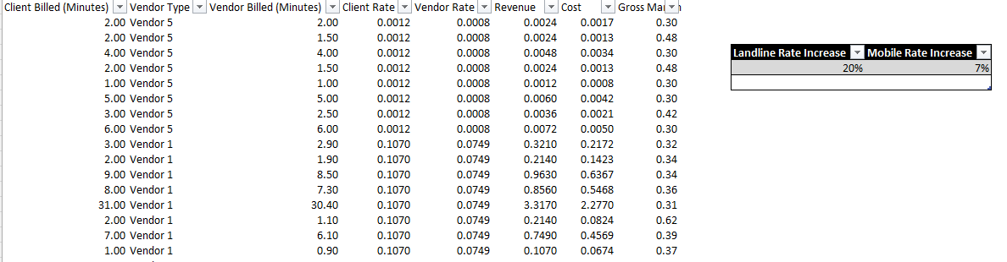
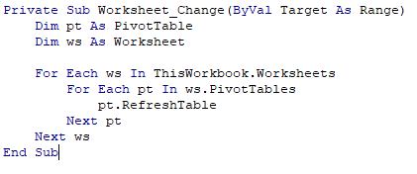
Automate: Calculation & Visualization
VBA :
Automate flexibility in testing the rate increment
Copying into new file ‘master_automate’ to run as data source for Power BI.
Table to enter different rate value.

Slide 17
Rate Simulation

Slide 18
Landline and mobile rate increment
Automate flexibility in testing the rate increment
Splitting into new DataFrame, security purpose and comparison
Comparing before and after value based on the rate adjusted
Customer | Total Billing (Client) | Adjusted Billing | Difference
4 | $18,095.18 | $20,431.43 | $2,336.25
37 | $18,065.45 | $20,384.75 | $2,319.30
8 | $15,150.11 | $17,142.29 | $1,992.18
26 | $10,389.24 | $11,504.19 | $1,114.95
10 | $9,210.20 | $10,418.98 | $1,208.78
3 | $3,809.43 | $4,219.41 | $409.98
1 | $2,288.63 | $2,584.75 | $296.12
15 | $2,177.70 | $2,497.68 | $319.98
2 | $1,477.05 | $1,650.35 | $173.30
22 | $1,262.53 | $1,459.01 | $196.48

Slide 19
Business Question

Slide 20
Business Question
Changes if increased the mobile rate by 7% and the landline rate by 20%??
There is no significance changes towards the gross margin except for Total billing per client and Total Cost per vendor
Refer table for the difference:
Total Bill per Client
Customer | Total Billing | Total Billing Adjusted | Difference
Client 22 | $ 1,262.53 | $ 1,459.01 | $ 196.48
Client 2 | $ 1,477.05 | $ 1,650.35 | $ 173.30
Client 15 | $ 2,177.70 | $ 2,497.68 | $ 319.98
Client 1 | $ 2,288.63 | $ 2,584.75 | $ 296.12
Client 3 | $ 3,809.43 | $ 4,219.41 | $ 409.98
Client 10 | $ 9,210.20 | $ 10,418.98 | $ 1,208.78
Client 26 | $ 10,389.24 | $ 11,504.19 | $ 1,114.95
Client 8 | $ 15,150.11 | $ 17,142.29 | $ 1,992.18
Client 37 | $ 18,065.45 | $ 20,384.75 | $ 2,319.30
Client 4 | $ 18,095.18 | $ 20,431.43 | $ 2,336.26
Grand Total | $ 81,925.51 | $ 92,292.84 | $ 10,367.33
Total Cost per Vendor
Vendor | Total Cost | Total Cost Adjusted | Difference
Vendor 5 | 1639.39 | 1847.80 | 208.41
Vendor 2 | 4483.61 | 5086.37 | 602.76
Vendor 3 | 7186.48 | 8145.40 | 958.92
Vendor 1 | 18487.05 | 20647.52 | 2160.46
Vendor 4 | 19275.99 | 21776.18 | 2500.19
Grand Total | 51072.52 | 57503.27 | 6430.74

Slide 21
Business Question
What is this data telling us?
There is a clear difference between client billing logic and vendor cost structure, which directly affects profitability.
Certain clients consistently yield lower margins due to:
High vendor rates
Low client billing rates
Short duration calls with inefficient billing increments (e.g., billed per minute but actual call is 10 seconds.
There is a clear difference between client billing logic and vendor cost structure, which directly affects profitability.

Slide 22
Business Question:
Changes make to have the overall Gross Margin to be at 45% ?
To reach a 45% overall gross margin, the company need to reduce the total vendor by approximately $4,575.30
The estimation of cost reduction per vendor listed as below:
Vendor | Cost Reduction Needed
Vendor 4 | 2900.05
Vendor 1 | 2821.73
Vendor 2 | 314.97
Vendor 3 | 309.29
Vendor 5 | -1770.75
Vendor 4 and 1 accounts for ~70% pf the total cost reduction required
Vendor 5 aperforming above the required margin with a surplus of approximately $1770
Vendor 2 and 3 require moderate cost reductions
Conclusion:
Prioritize renegotiations with Vendor 4 and Vendor 1 to bring their pricing closer to the target vendor cost level.
Set cost benchmarks internally based on Vendor 5’s performance.
Explore alternative vendors or lower-cost for high-volume destinations.

Slide 23
Recommendations and Risks

Slide 24
Recommendations and Risks
Insights
Significant margin variability across clients and vendors
Short duration calls impact profitability when billed per minute
Monthly patterns suggest behavioral or seasonal changes
Some vendors are costlier for similar destinations
Opportunities
Rethink Routing:
Some call routes are costing more than they bring in. It’s worth reviewing these and seeing if you can negotiate better deals with vendors or switch to more affordable carriers.
Update Client Agreements:
A few clients are using a lot of minutes but paying too little. Their contracts might be outdated and not in line with current costs.
Introduce Tiered Pricing:
Consider offering pricing based on usage levels. This way, high-usage clients pay a bit more, helping to balance out the costs and boost profit margins.
Adjust for Short Calls:
If a lot of calls are really short, and the billing per second, company could be losing money. Switching to billing in 30-second increments (or similar) could help recover more revenue from those short calls. ( “Follow vendor charging method”).
Rate Adjustment:
Instead of increasing both the landline and mobile rates across the board, the rate adjustments should focus on improving the company’s margins—not just passing on more profit to the carrier.
For example, raise the rates charged only to the client, not from the vendor. This way, we can avoid a situation where higher vendor costs eat into our revenue and cause a deficit

Slide 25
Thank you
Nasrul Khair
017-716 3119
nasrul.bursa@gmail.com
nasrulkhair.github.io

